Slide 1
Mobile Safety Project
Feb 23. 2017

Slide 2
What was done
Write scrapy program to crawl more Android App
Observe ‘Casino’ subcategory
Try to find pattern in “Ninja” apps

Slide 3
Test Set 1- “Casino” subcategory
Finding 1. Subcategory could be a very important feature.
Only two levels of rating for “Casino” subcategory
-Teen: Simulated Gambling, Suggestive Themes, Use of Alcohol and Tobacco
-Mature 17+: Partial Nudity, Simulated Gambling, Suggestive Themes
Rule for “Casino” subcategory:
All are ‘Teen’ level, if not, suspicious app
If have Nudity content, then become “Mature 17+”

Slide 4
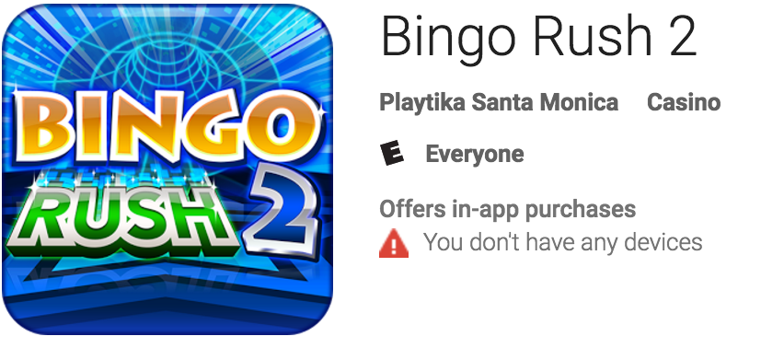
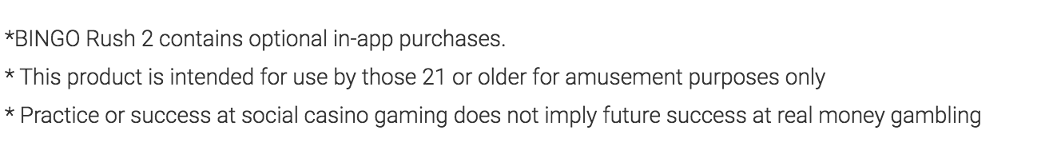
Suspicious App 1:
Underrate to get more download.
Possible Reasons:
1. Google has no detect system, let developer report mature rating by themselves.
2. Developer want to get away rules, by adding “21 or older” in the descrpition.

Slide 5
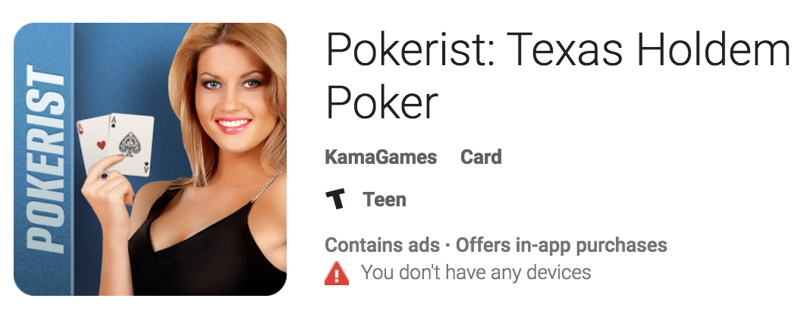
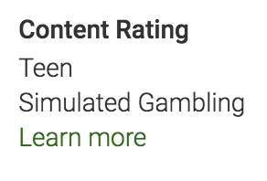
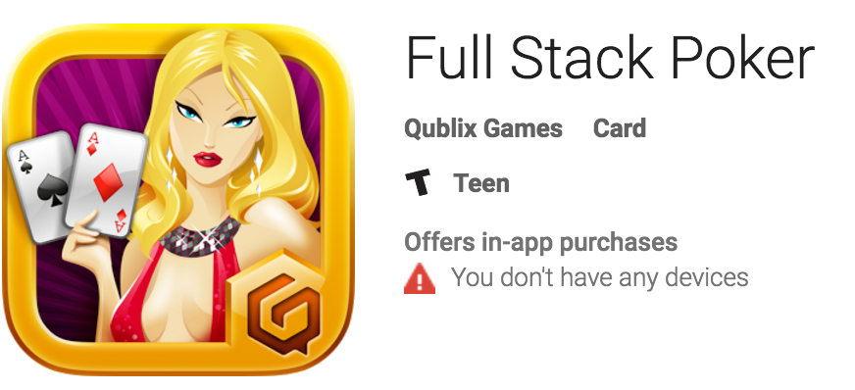
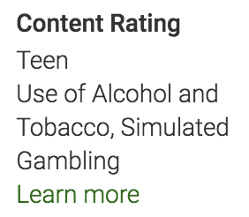
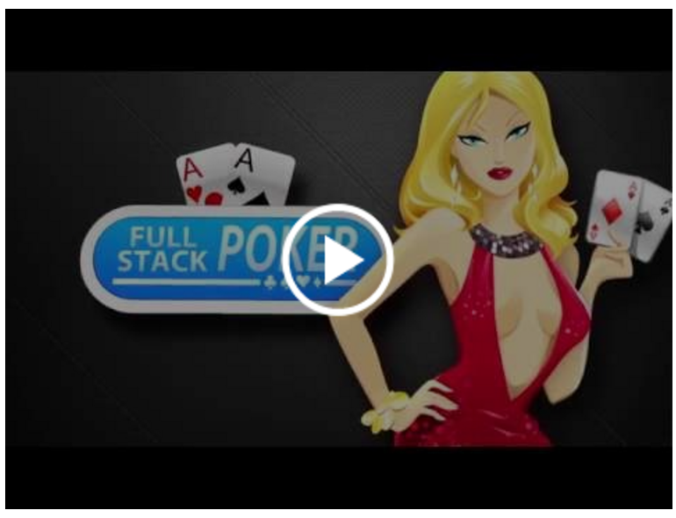
Suspicious App 2:
Rating ‘Teen’ should be ‘Mature 17+’
Nothing in the description, but expose girl picture in the icon, indicating “Nudity” component in the game.
Possible solution:
Add image detection

Slide 6
Potential Lexicon for “Casino” category
Gambling:
Casino, Bingo, gambling
Porker, Coin, tournament, chip, spin, win, slot, payout, jackpot
Las Vegas, Vegas, Macau
Nudity, Sexual:
Start your fantasy casino journey with our awesome characters. Lady Femida, Thief, Vampire Hunter, Ice Baby, Genie, Dangerous Twins and other fantastic characters are waiting for you.
Alcohol:
Digital beer
Direct rating related:
Intended for adults
Intended for those 21 or older
Addicting
This game is only available to people of legal age.
The game is design for an adult audience

Slide 7
Test set 2 – “Ninja” apps
29 “Ninja” apps in “Action” subcategory
“Violence” words pick from top frequency words by human judgement
V1 = ['ambitious', 'animation', 'challenging', 'darkness', 'disguises', 'dragon', 'dragons', 'jump ', 'legend', 'legendary', 'legends', 'magic', 'master', 'mission', 'obediently', 'obstacles', 'run', 'terrible', 'tournament', 'weakness']
V2 = ['addictive', 'adventure', 'adventures', 'angry', 'army', 'battle', 'battles', 'bomb', 'bombs', 'conquer', 'dangerous', 'deadly', 'defeat', 'destroy', 'destroying', 'dodge', 'enemies', 'enemy', 'hit', 'intense', 'samurai', 'sneak', 'sneaking', 'survive', 'warrior', 'warriors', 'zombies']
V3 = ['assassin', 'attack', 'beat', 'blade', 'blades', 'dead', 'devil', 'devils', 'kill', 'killing', 'shoot', 'shot', 'sword', 'weapon', 'weapons']
V1 - Mild Violence
V2 – Medium Violence
V3 – Strong Violence
Code in file “Ninja.ipynb”
Result in file “Ninja_V1V2V3.csv”

Slide 8
How to Create Lexicon
1. Find Social Science lexicon “sentiment”, “offensive” list
2. Key – word frequency (read smoke word paper)
3. Chi - square approach

Slide 9
How to calculate similarity?
Semantic base:
Each term is a feature(term document frequency)
Method: Cosine-similarity…
(Can be the benchmark)
2. Intensity base:
Group lexicon by intensity, each intensity is a feature
radar chart, if 2pps radar chart matches -> similar app-> similar rating

